Slide 1

OSI
Visualizing Global land temperatures and CO2 emissions
Group 3
Kha
Joseph
Lotta

Slide 2
DESCRIPTION
DATA

Slide 3
Data Origin
The base file is GlobalLandTemperaturesByCountry.csv, courtesy of Kaggle data repository
(https://www.kaggle.com/datasets/berkeleyearth/climate-change-earth-surface-temperature-data?select=GlobalLandTemperaturesByCountry.csv)
Additional file called owid-co2-data.csv, which is about data on CO2 and greenhouse gas emissions by Our World Data
(https://github.com/owid/co2-data)

Slide 4
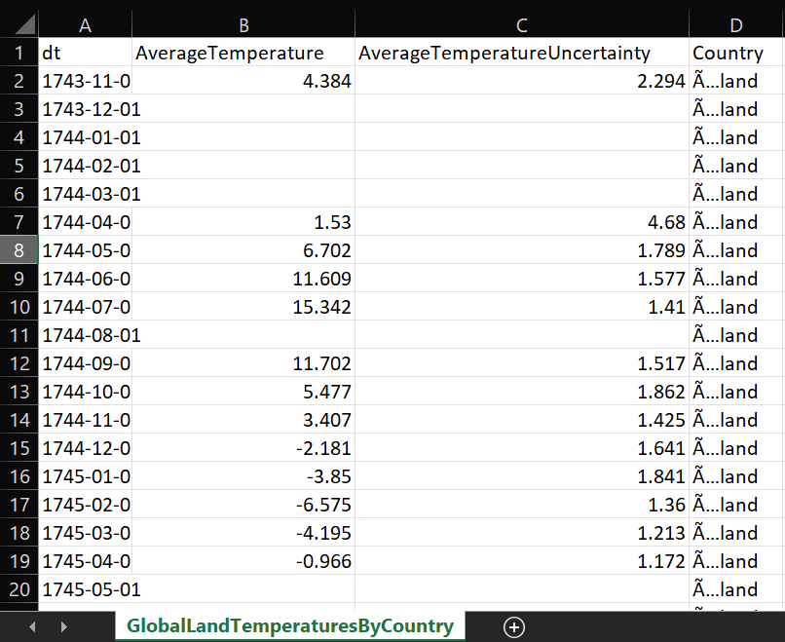
GlobalLandTemperaturesByCountry.csv

Slide 5
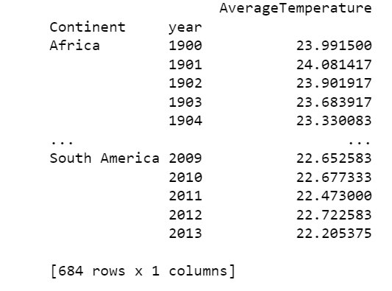
GlobalLandTemperaturesByCountry.csv

Slide 6
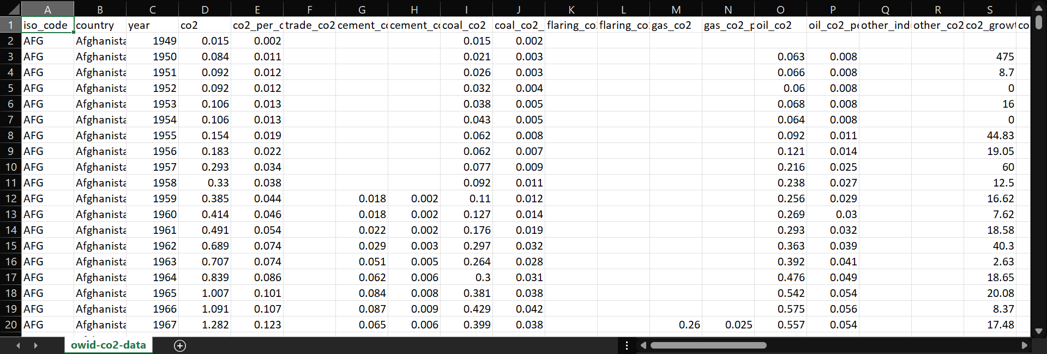
owid-co2-data.csv

Slide 7
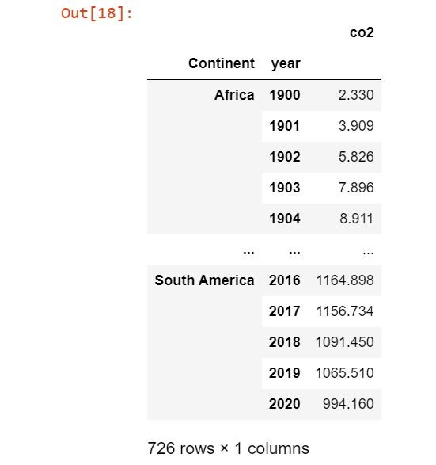
GlobalLandTemperaturesByCountry.csv
owid-co2-data.csv

Slide 8
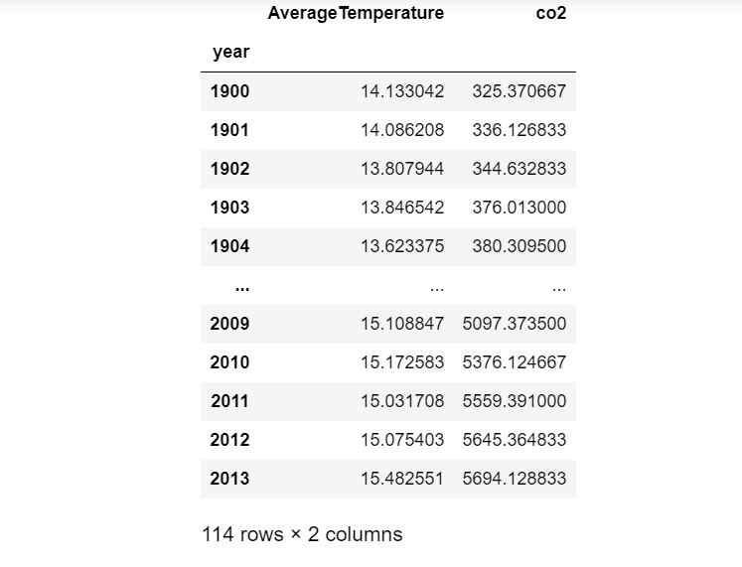
Merged DataFrame

Slide 9
Description of functions and charts

Slide 10
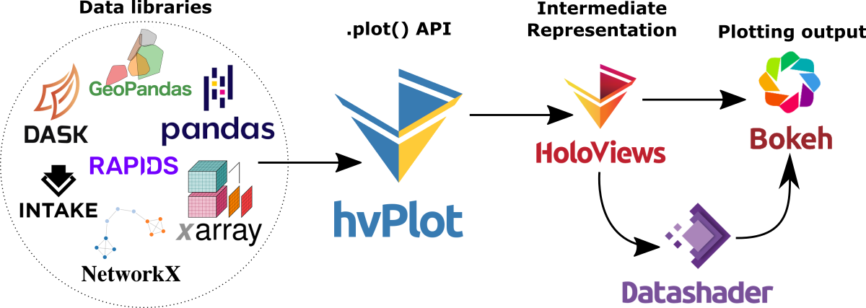

Slide 11
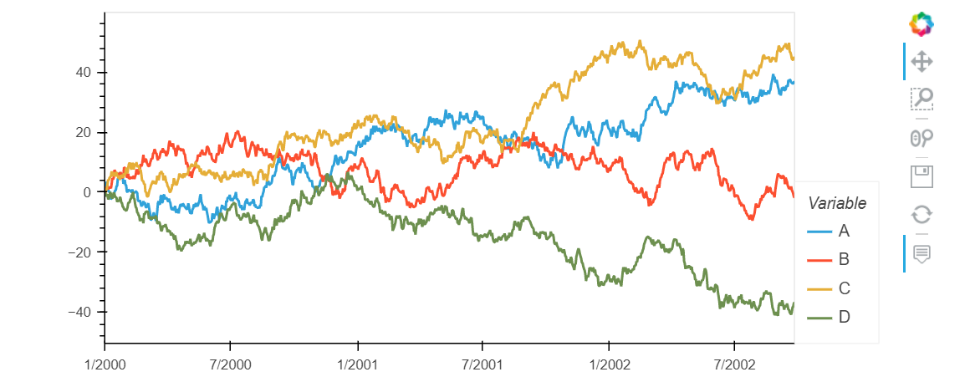

Slide 12
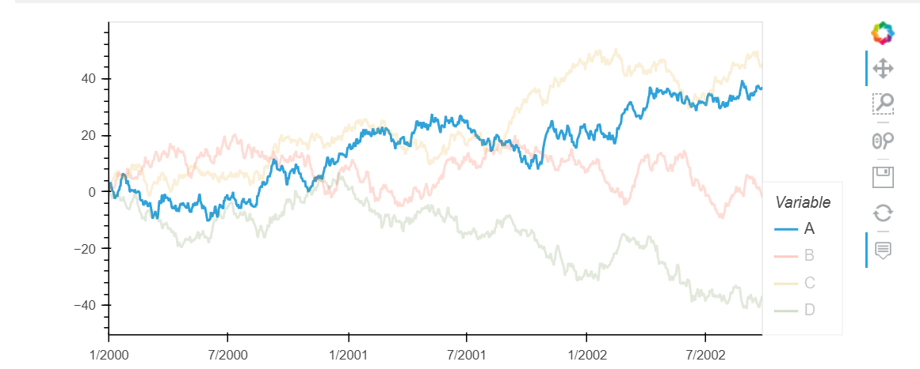

Slide 13
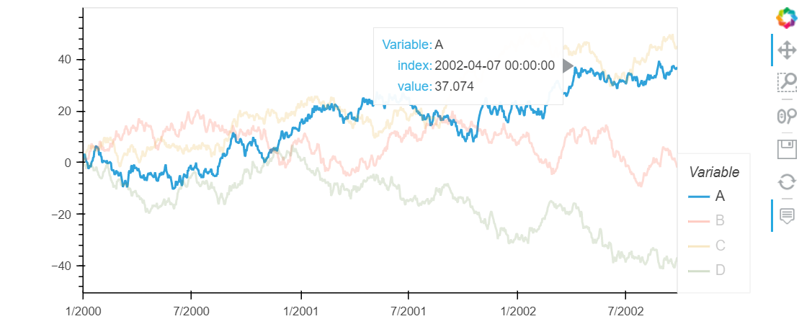

Slide 14
DATA VISUALIZATION
Global average temperatures
Global CO2 emissions
Average CO2 emissions by continents

Slide 15
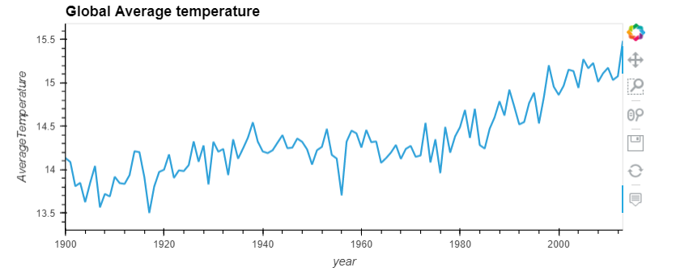
Global average temperatures

Slide 16
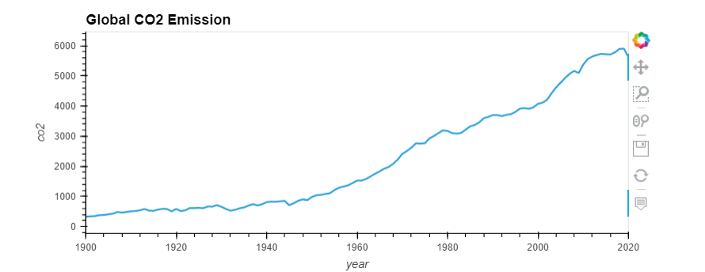
Global CO2 emissions

Slide 17
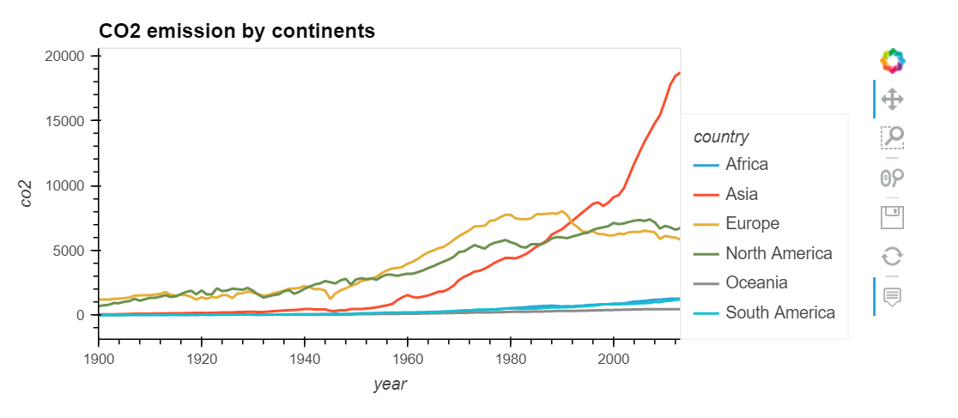
Average CO2 emissions by continents

Slide 18
Conclusion
There is a yearly increase in the global average temperature
We also learned that there is a strong relationship between the yearly average temperature and the co2 emission levels.
Carbon dioxide and other greenhouse gases are responsible for the global warming. This has its impacts on the environments.

Slide 19
Pre-analyzing datasets: Lotta, KHA, Joseph
Analyzing Data: Lotta, KHA, Joseph
Project Planning: Lotta
Data cleaning: Joseph
Visualization: KHA
Group 3

Slide 20
THANK YOU
FOR LISTENING
Group 3

